Slide 1
RVAPT 3
Active Enumeration

Slide 2

Found Anything?

Slide 3
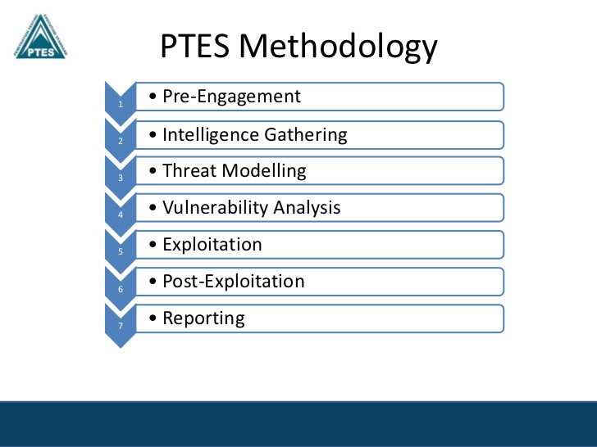
Agenda
Enumeration - Review
What is Active Enumeration?
Active Enumeration
Network
Application
Active Directory
Services and You
Lab Time

Slide 4
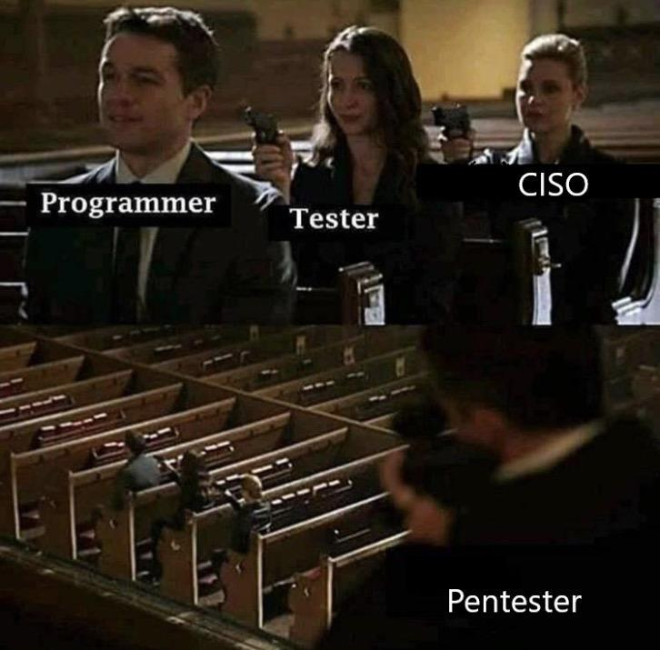
Enumeration - Review
What is Enumeration?
Importance?
Key Questions?

Slide 5
Enumeration - Review
Gather information about the target, in order to use it for later phases - Vulnerability Assessment, Penetration Testing
Importance
Key Questions
What is it?
What is the context?
What does it do?
What can I get from it?
What do I need?

Slide 6

I’m BACK

Slide 7
Active Enumeration
Enumeration performed through directly interacting with the target
Valid Requests
Malformed Requests
A LOT of Requests - Bruteforcing
Valid Requests
Loose Configuration
Lack of Security Awareness → “That’ll be fine, np”
Malformed Requests
Taking advantage of error messages
A LOT of Requests
If allowed: Ask valid questions, A LOT

Slide 8

Active Enumeration - Network
Questions
What hosts are in this network? Which of them are important?
How do they interact with each other?
Network Discovery
Host Discovery
Map all hosts
Focus on hostnames - Real World
Port Scan
Map all network services
TCP/UDP
Service Enumeration
Oh boy we have lot to cover

Slide 9
Services and You
(21) FTP - File Transfer
Anonymous login, Read/Write Permission, Chroot, File Execution
(22) SSH
Bruteforce, Password Spraying
(25) SMTP
Username verification → bruteforcing
(53) DNS
Zone Transfer - zonetransfer.me
Subdomain bruteforce
(139/445) SMB
Null Session, MS08/17 - RCE, Read/Write permission
(1433/3306/5432/27017) DB
Anonymous login, weak password, read/write permission

Slide 10
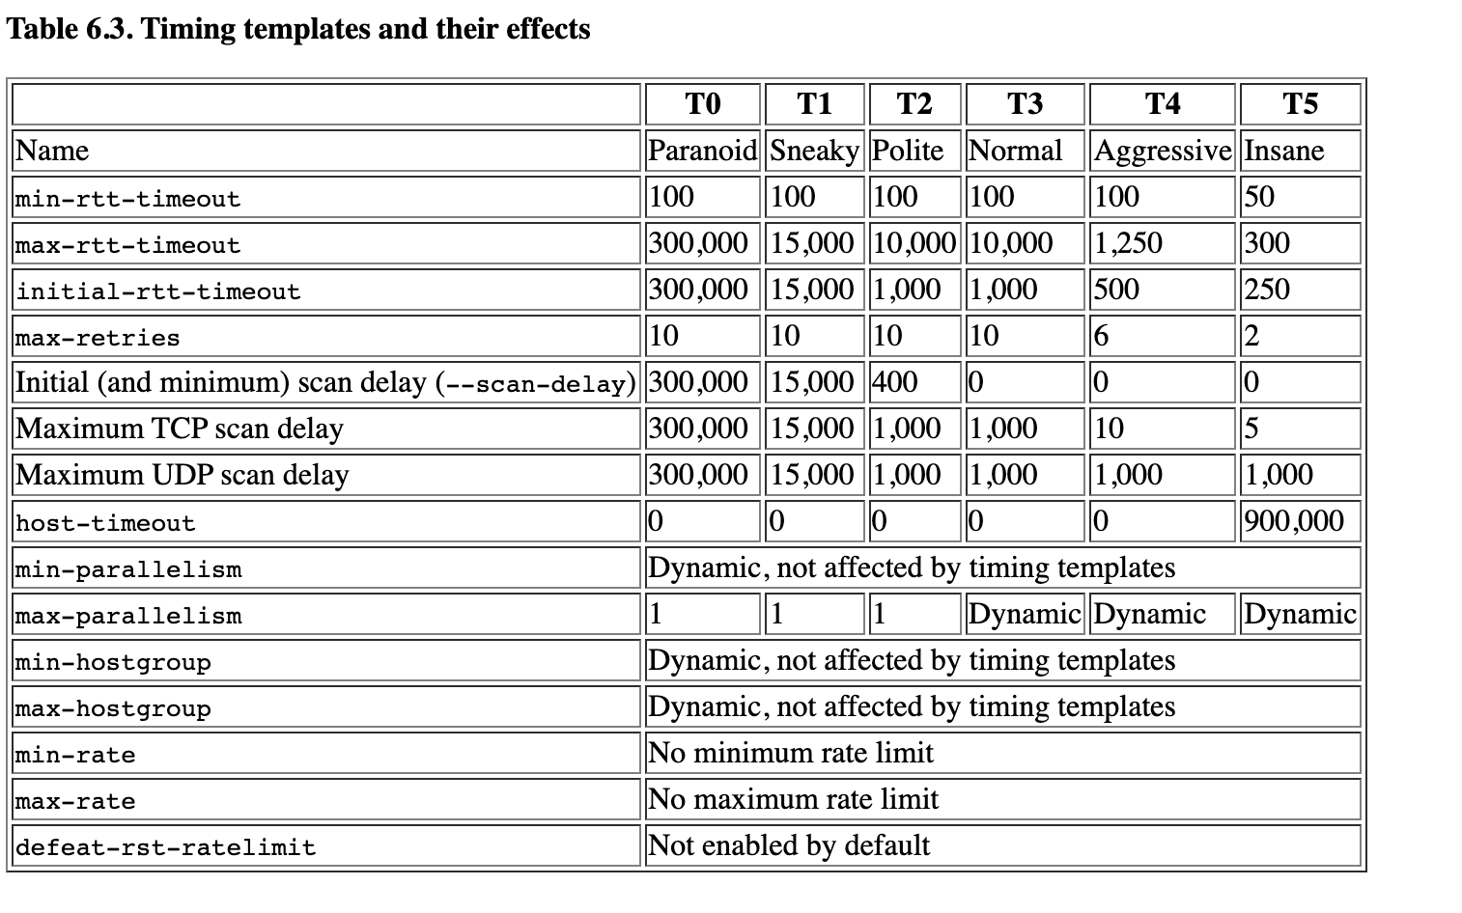
Details

Slide 11
Details Cont.
Host Discovery - nmap
nmap -sn --min-parallelism 50 --max-parallelism 100 -n -T4 -oA subnet_ping <ip/CIDR>
Formatting: nmap -sn -n 10.2.200.0/23 | grep 'Nmap scan report for' | cut -f 5 -d ' ' > nmap/live_hosts.txt
Can then use -iL to import the list during portscan
* What if host has ICMP enabled? use -Pn and scan common ports
Port Scanning
nmap -p- --max-retries 2 -T4 -v -oA full_tcp <ip>
nmap -p- --max-retries 1 -T4 -sU -oA full_udp <ip>
Detailed - Banner Grab + Basic Vuln Scan
nmap -sCV -T4 -v -p<ports> -oA detailed_tcp <ip>

Slide 12
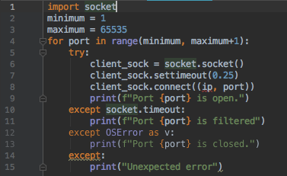
Less Sexy - For the minimalists ;)
Bash Port Scan One-Liner
for port in {1..65535}; do timeout 1 bash -c "echo >/dev/tcp/10.3.16.128/$port" >/dev/null 2>&1 && echo "port $port is open"; done
Python:

Slide 13
Active Enumeration - Application
What application is this?
Name
Version
What does it do?
The Tech Stack
LAMP - Dynamic Web Sites
MEAN - Full Web Application
Directories
Gobuster, dirbuster, wfuzz
Endpoint Parameters
GET, POST, API
What business logic does this endpoint have?

Slide 14
Details
Looking at source code, robots.txt, SSL certificate
Gobuster
gobuster dir -w <wordlist> -u <url> -t 20 -x php,html,txt
Nikto
nikto -h <url>
Wfuzz
wfuzz -w <wordlist> --hc 404 http://example.com/FUZZ -t 20 -x php,html,txt

Slide 15


Active Enumeration - Active Directory
The Basics
Domain, Tree, Network, Trust
Users
Users, groups, built-in users
Objects
Computers, ACLs
More!
Open Shares
Sensitive Files
Fileservers
DC

Slide 16
Details - Outdated (RIP PS)
Basic Tools
PowerView.ps1
Microsoft.ActiveDirectory.Management.dll
SharpXYZ - C#
Basics
Get-ADDomain
Get-ADDomainController
Get-ADUser -Filter * -Properties *
Get-ADGroup -Filter * | select Name
PowerView
Invoke-ShareFinder
Invoke-FileFinder
Invoke-UserHunter → Find all current DA session
Find-LocalAdminAccess → Find all machines that current user has local admin access

Slide 17
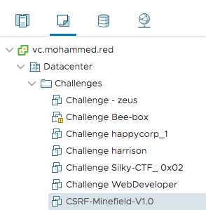
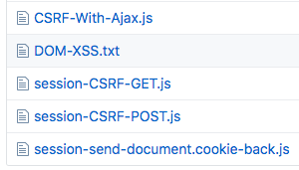
How to practice
OWASP juice shop (VM)
CSRF-Minefield (VM)
DAMN vulnerable web application (Application)
Bee-box (Application)
WebGoat (Application)
HacktheBox (Platform)
Vulnhub (Website)
Build your own LAB!

Slide 18
That was a lot...

Slide 19
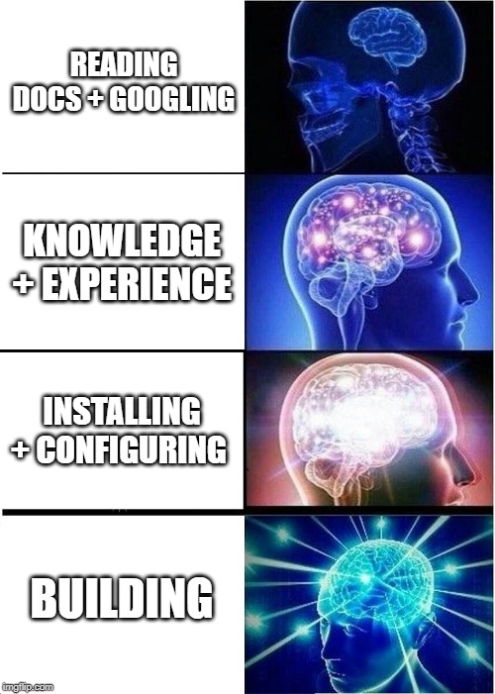

Slide 20
Lab Time!

